Slide 1


The Importance of User Experience for Developers
Presented for:
Sarah Dutkiewicz
Cleveland Tech Events
Notes:
Presented at Kansas City Developer Conference 2017

Slide 2



































TITANIUM SPONSORS
Platinum Sponsors
Gold Sponsors

Slide 3
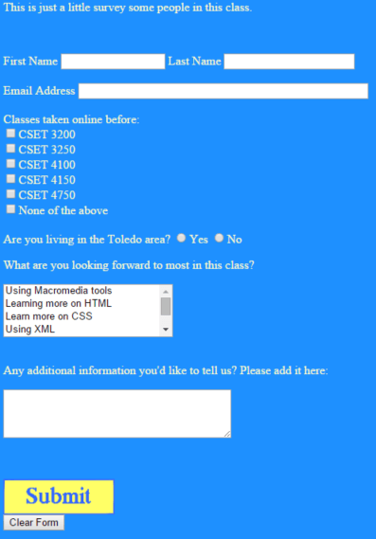
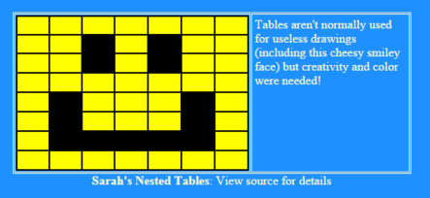
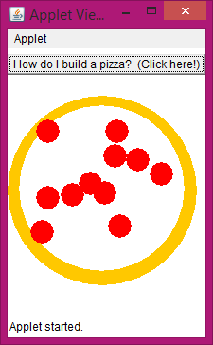
Note: Not a Graphics Designer!
Notes:
Yes… DodgerBlue and LemonChiffon… an unhealthy obsession :P But it’s a good way to tell if I’m the one laying out the site before the designers have come around.

Slide 4
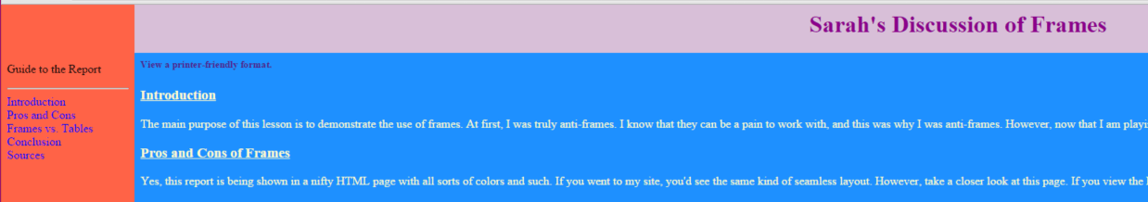
Note: Really Not a Graphics Designer!

Slide 5

Background
Over 15 years in the field, as:
Tech support & management
Desktop support
Database administration
Web server administration
Reporting
Web development
Microsoft MVP
Iteration manager
Published technical author
Lead Instructor / Instructor / Adjunct instructor
Developer Mentor
Conference Organizer
Speaker
Blogger
Community advocate
B.S. in Computer Science & Engineering Technology

Slide 6
This Photo by Unknown Author is licensed under CC BY-SA

Slide 7
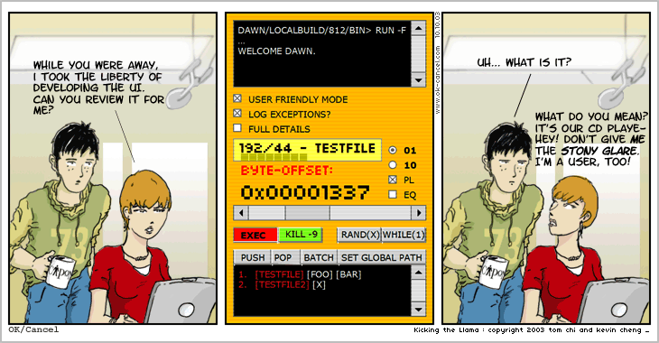
Not a Devigner…
OK/Cancel Comic at: http://okcancel.com/comic/4.html

Slide 8
Happy Little User Experiences
This Photo by Unknown Author is licensed under CC BY-NC-ND

Slide 9
This Photo by Unknown Author is licensed under CC BY-NC-ND

Slide 10

Check your egos at the door
Notes:
Picture from: https://c1.staticflickr.com/1/23/35635683_3868784c96_z.jpg

Slide 11
What is User Experience?

Slide 12

All About the Users

Slide 13
USER EXPERIENCE
DURING
BEFORE
AFTER
PERCEPTIONS
PREFERENCES
EMOTIONS
BELIEFS

Slide 14
Look
Feel
Usability
UI
Emotions
Beliefs
Physically
Psychologically
Functional
Intuitive
Visually appealing
Predictable
Consistent

Slide 15
Mapping User Experience to the Software Development Life Cycle

Slide 16
Analyze
Design
Testing
Development
Evolution/Finalize
Field Research
Face to Face Interviewing
Creation of user tests
Market research
Creating personas
Brainstorming
Mind maps

Slide 17
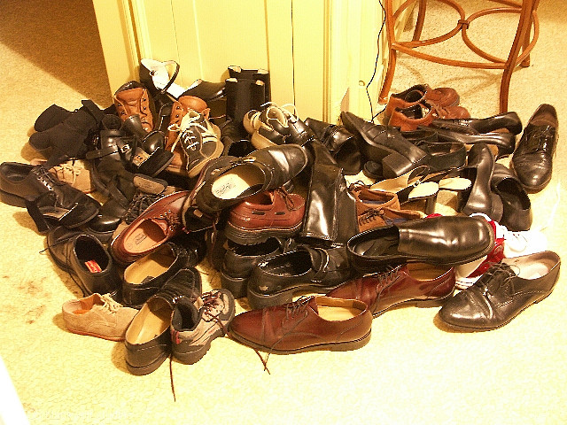
Put yourself in the users’ shoes
Notes:
Image source: https://www.flickr.com/photos/faelchon/15146022

Slide 18
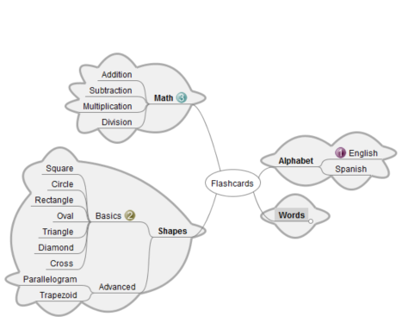
Mind Maps

Slide 19
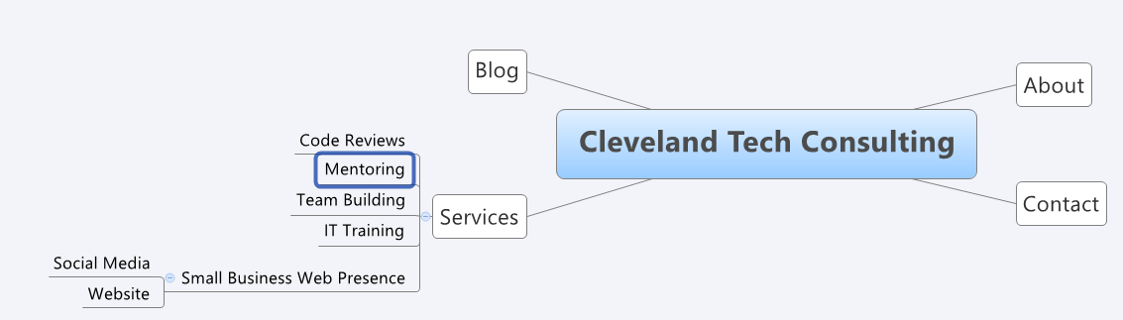
Site Maps

Slide 20
P e r s o n a s
José
Business Owner
Irene
Older Resident
Sarah
Younger Resident

Slide 21
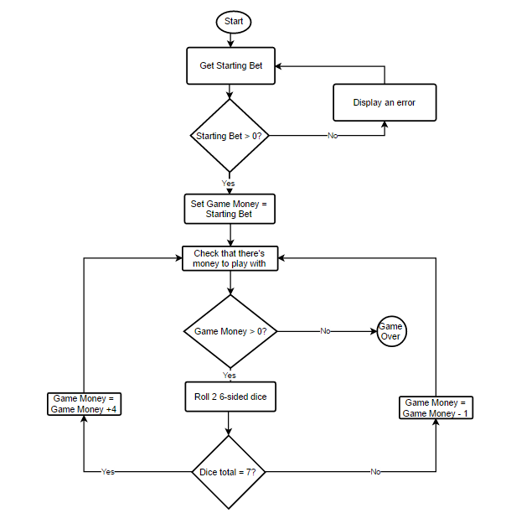
Flowcharts

Slide 22
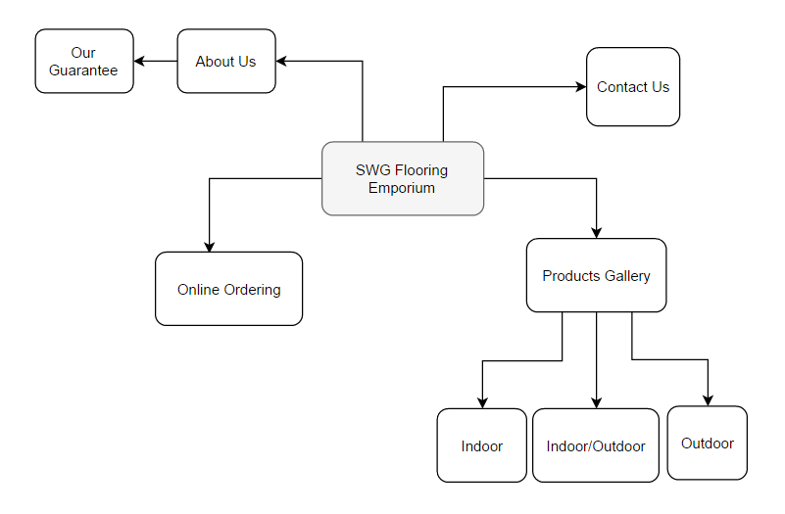
Site Maps
Notes:
Created with draw.io as a hypothetical site map for a Flooring Mastery website

Slide 23
Design
Testing
Development
Evolution/Finalize
Analyze
Product design
Feature writing
Requirement writing
Information architecture
Interaction design
Interface design
Visual design
Prototyping

Slide 24
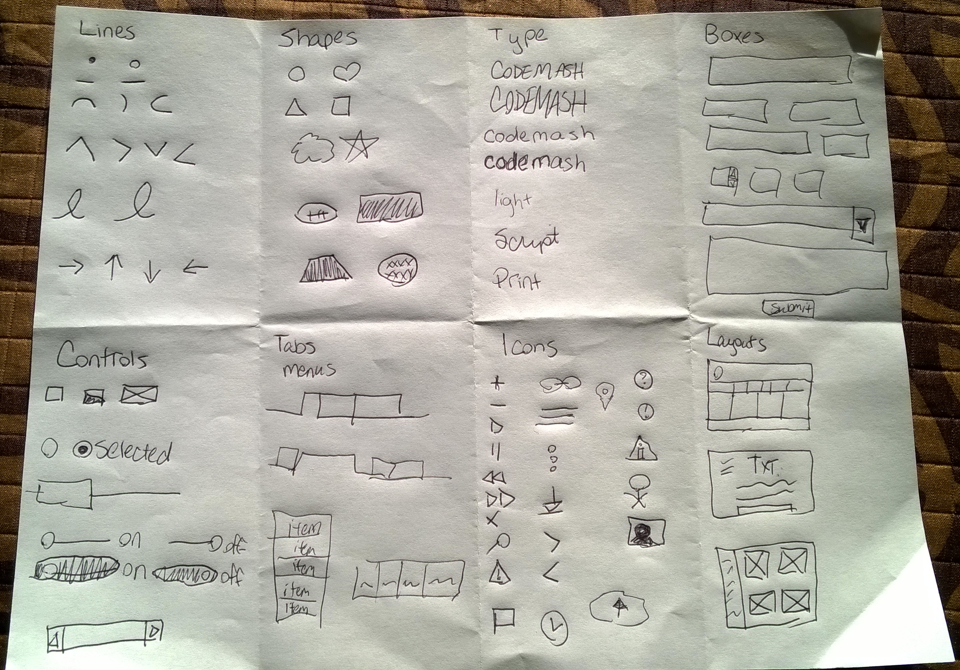
Learn to sketch…
#codemash2016 #uxjam

Slide 25

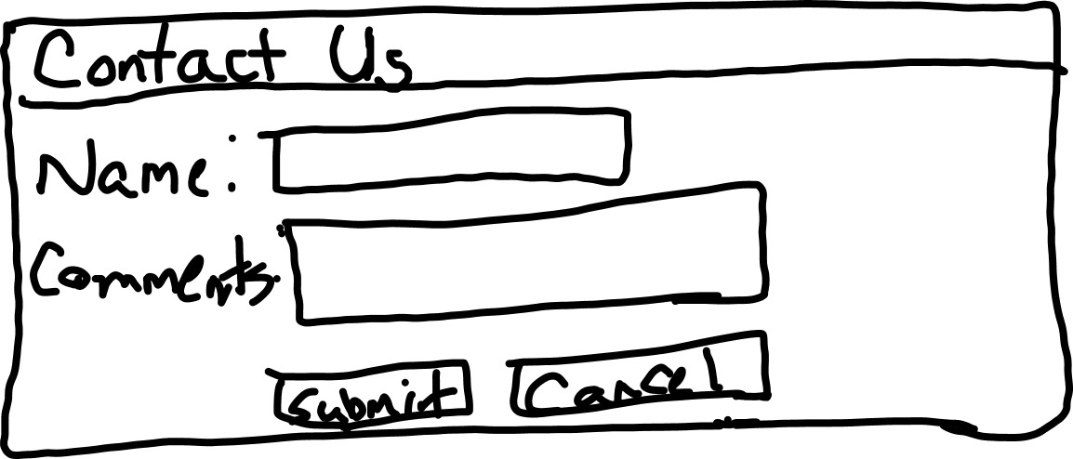
Wireframes

Slide 26
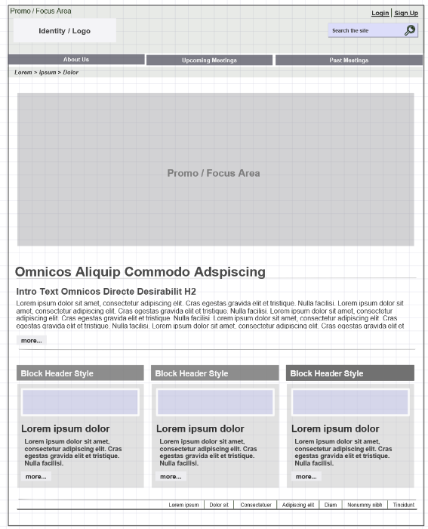
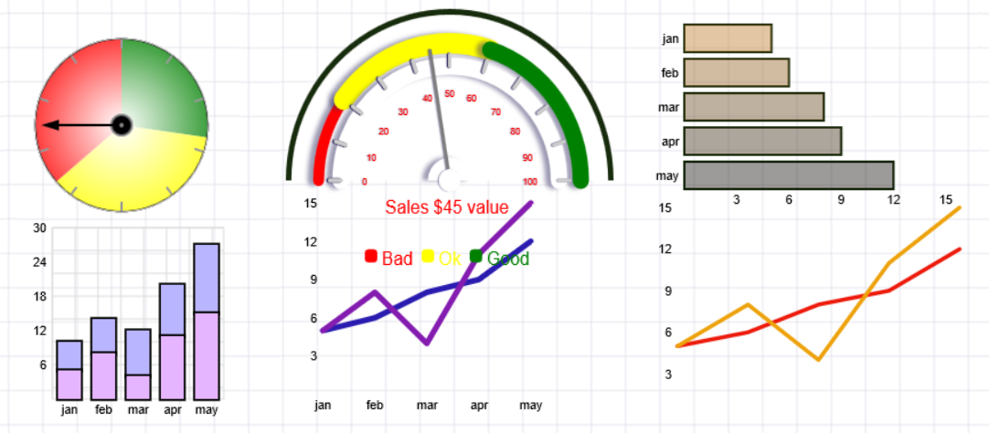
Wireframes.org
Built in templates
Wireframes, flow charts, etc.
Runs right in the browser

Slide 27
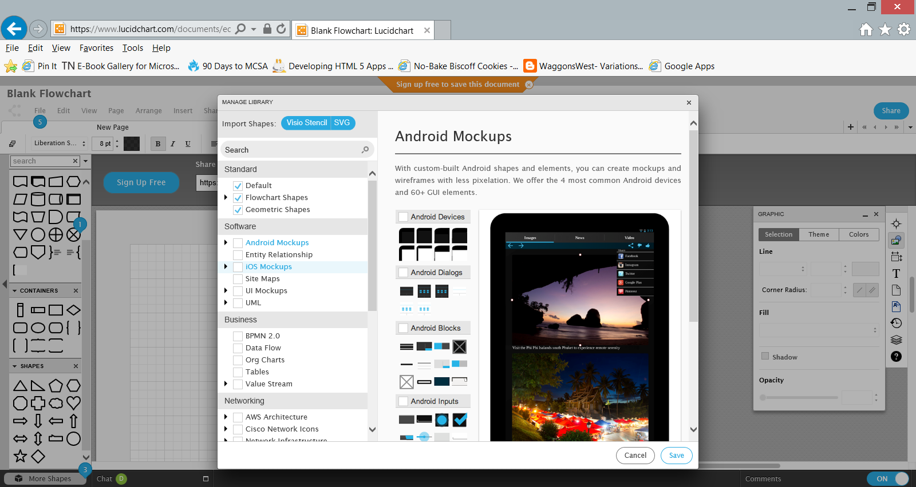
Lucid Charts

Slide 28
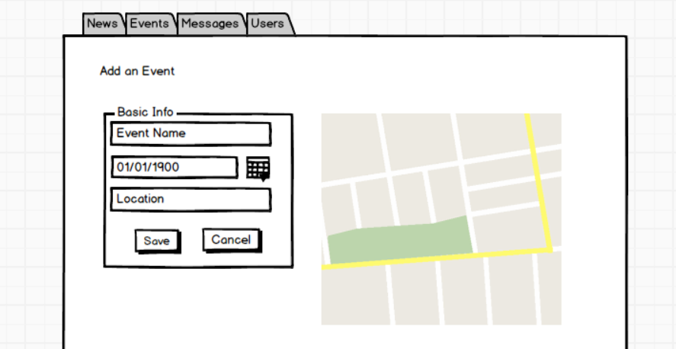
Balsamiq

Slide 29
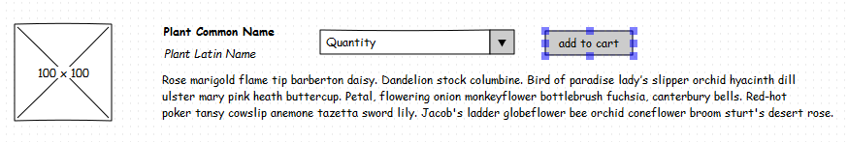
Pencil
Notes:
Flower ipsum generated at http://floweripsum.com/

Slide 30
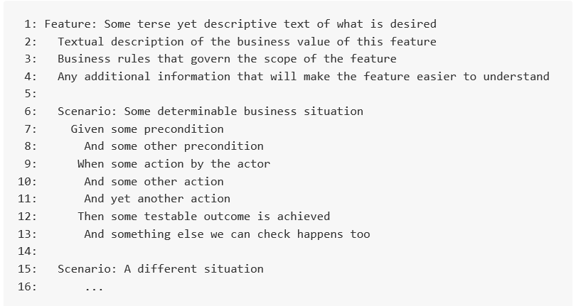
Writing Feature Files

Slide 31
Testing
Development
Evolution/Finalize
Analyze
Design
Information architecture
Copywriting
Usability
Graphic arts

Slide 32
DEVELOPER
ADVISORY
BE EXPLICIT

Slide 33
DEVELOPER
ADVISORY
BE CONSISTENT

Slide 34
Context is important

Slide 35

You’ve won the lottery!
Notes:
Image taken from: http://2.bp.blogspot.com/-N4rNIqhEJWw/TrXgZ6rrmEI/AAAAAAAACQg/c1geUm5kKaM/s400/urinedrugtest-public2.jpg

Slide 36

Image source: http://figures.boundless.com/30386/full/3678747186_0bfb0d6a01_z.jpg

Slide 37

Notes:
Image: https://robliano.files.wordpress.com/2013/06/r-multitasking-large570.jpg?w=640

Slide 38

Notes:
Image from: http://investorinthefamily.com/wp-content/uploads/2014/01/Financial-Planning.jpg

Slide 39
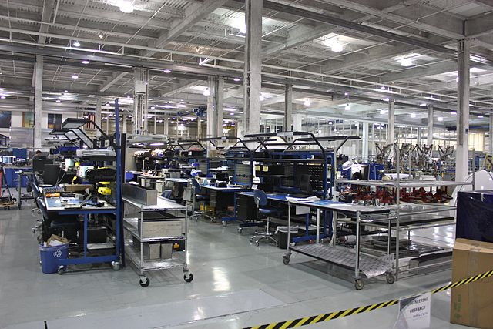
Notes:
Image taken from https://upload.wikimedia.org/wikipedia/commons/e/e5/SpaceX_factory.jpg

Slide 40
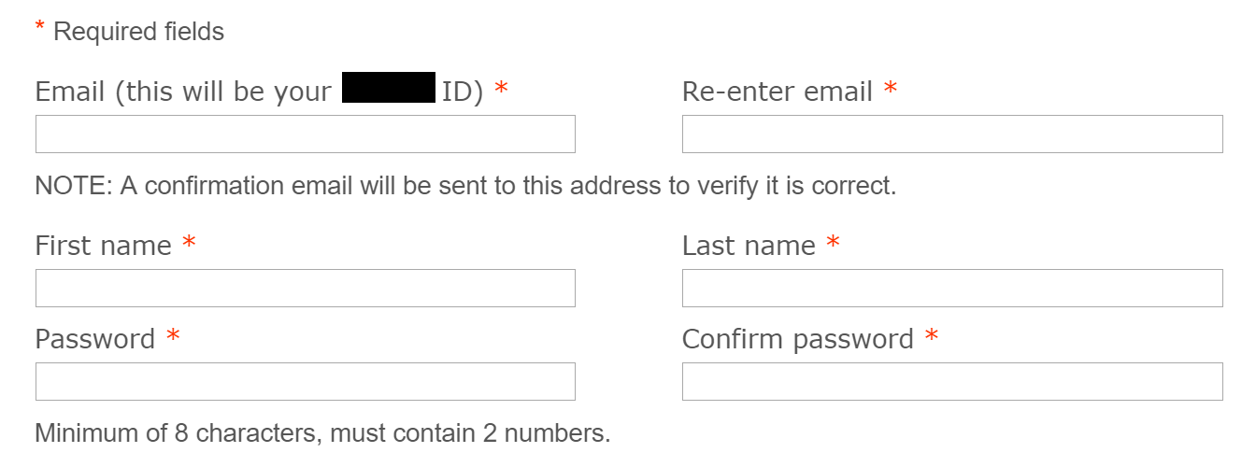
Contextual Help

Slide 41
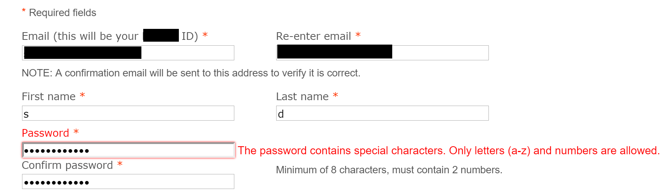
When Contextual Help Goes Awry…

Slide 42
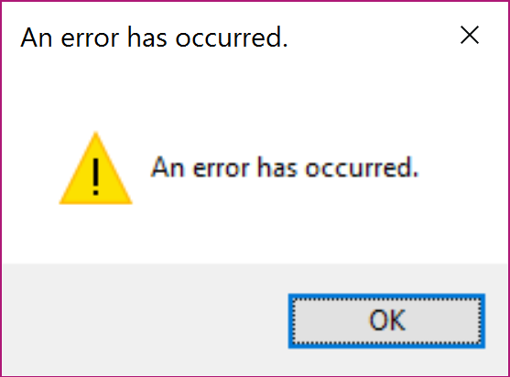
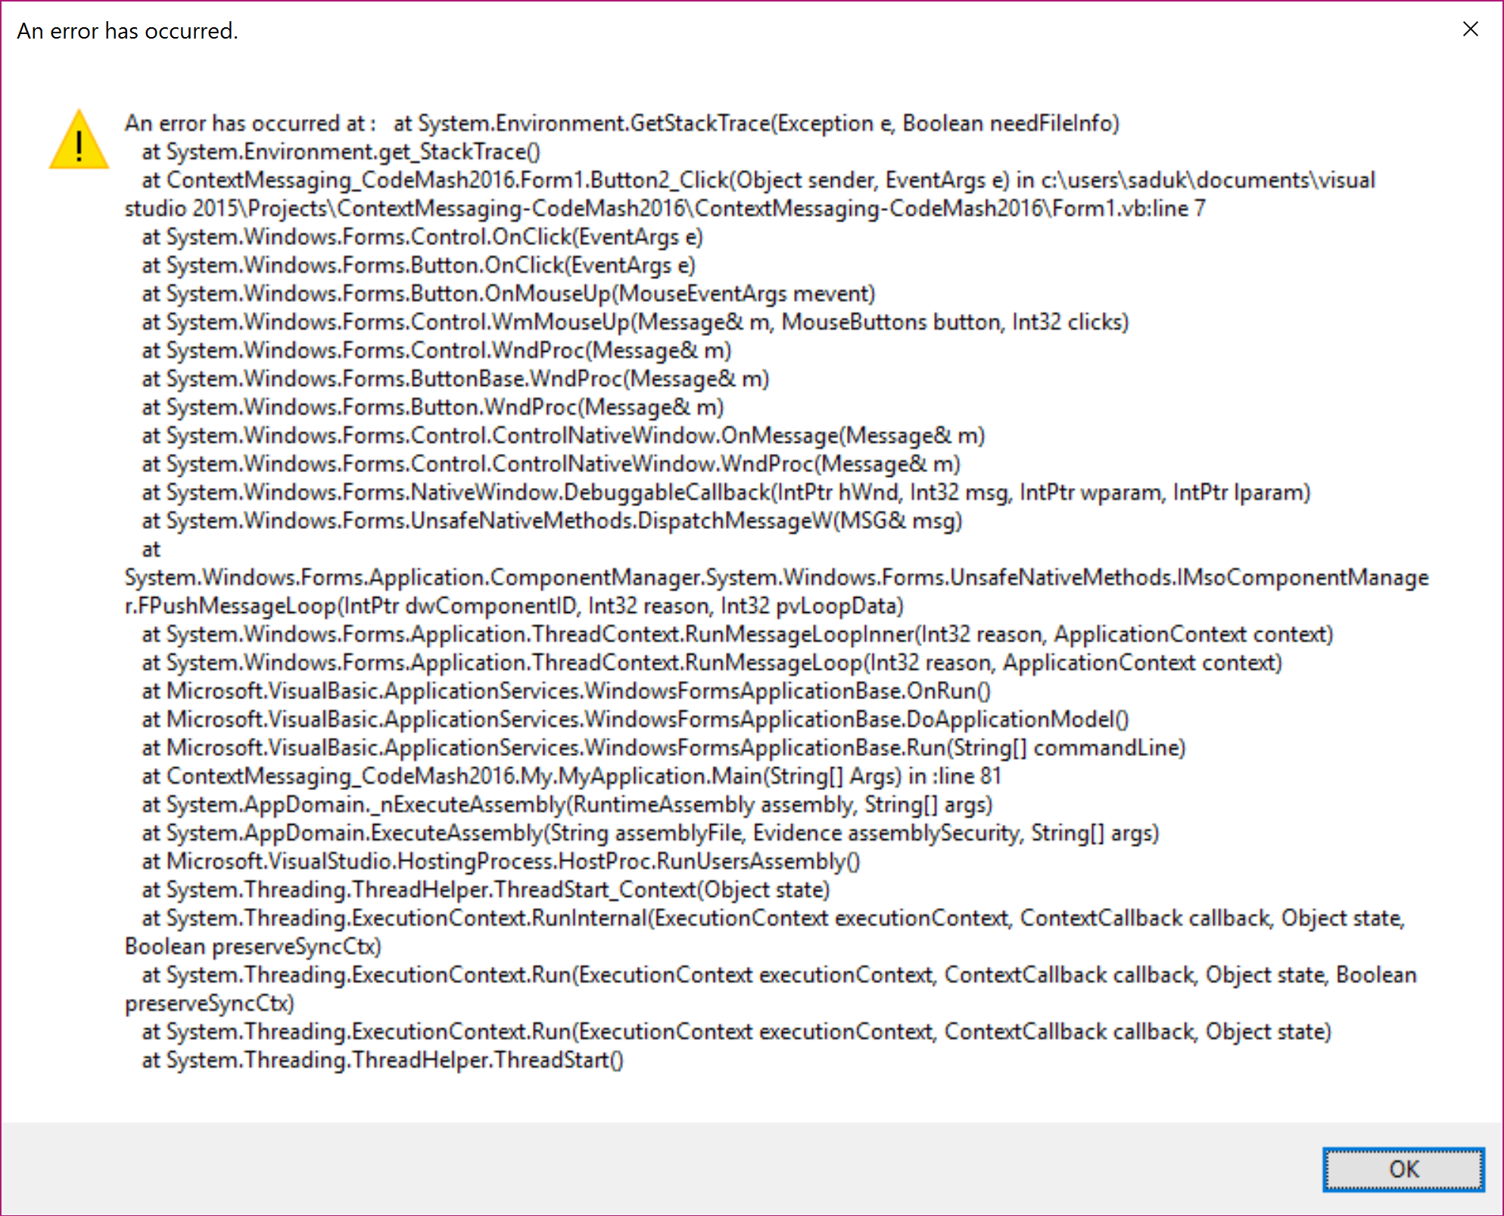
Useless errors

Slide 43
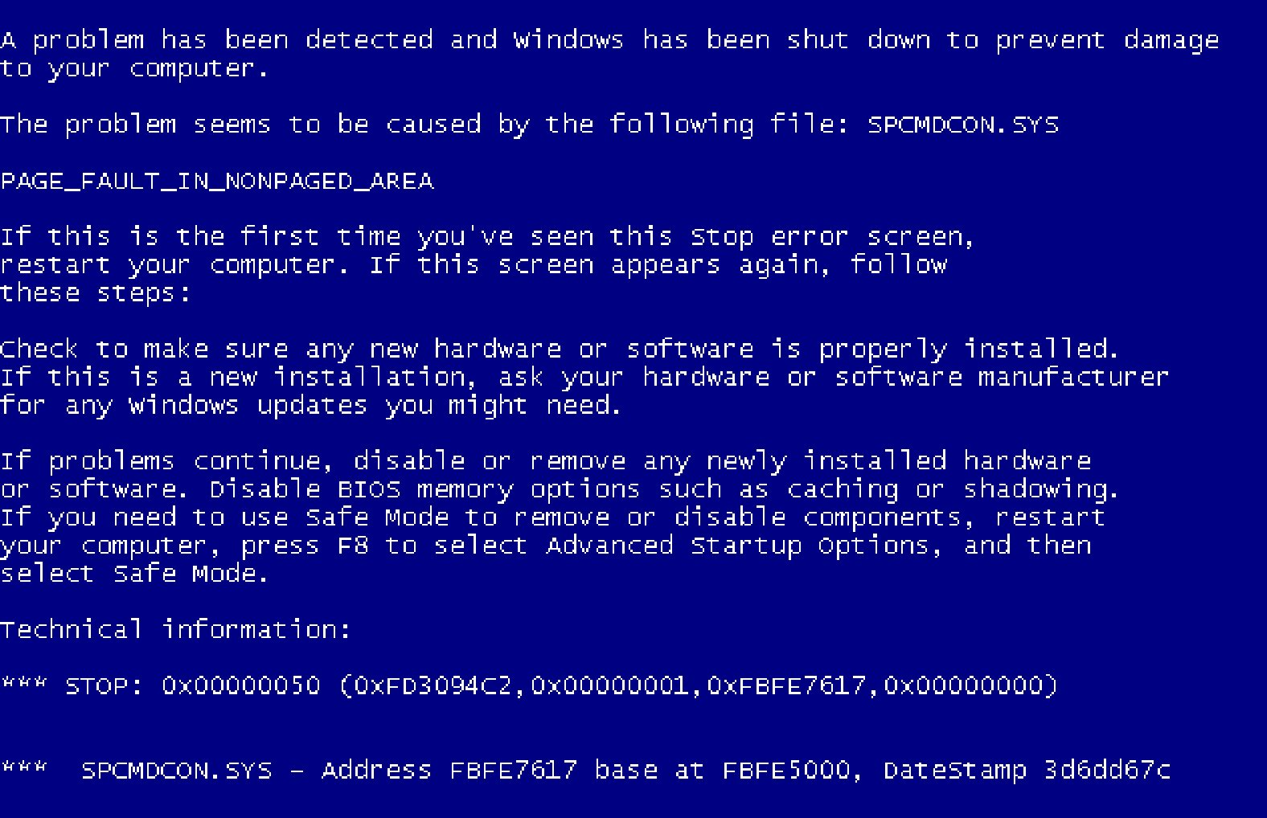

Slide 44
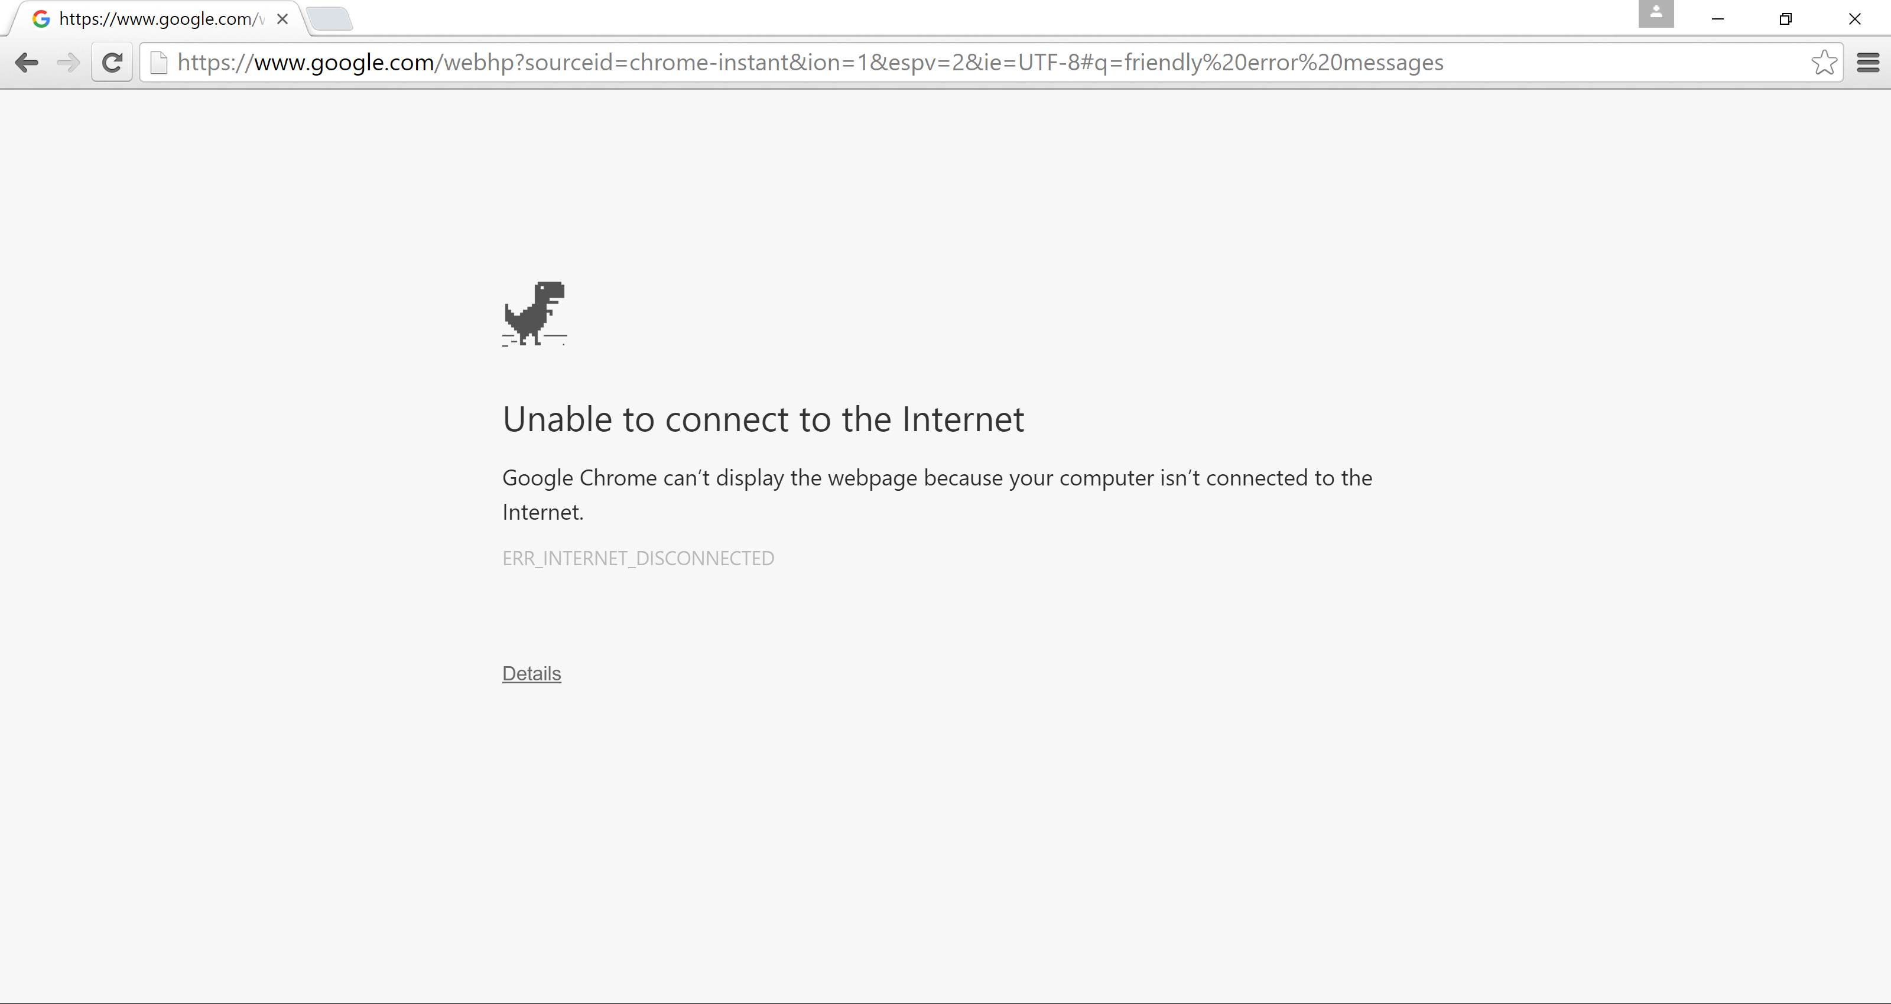
Actionable Errors

Slide 45
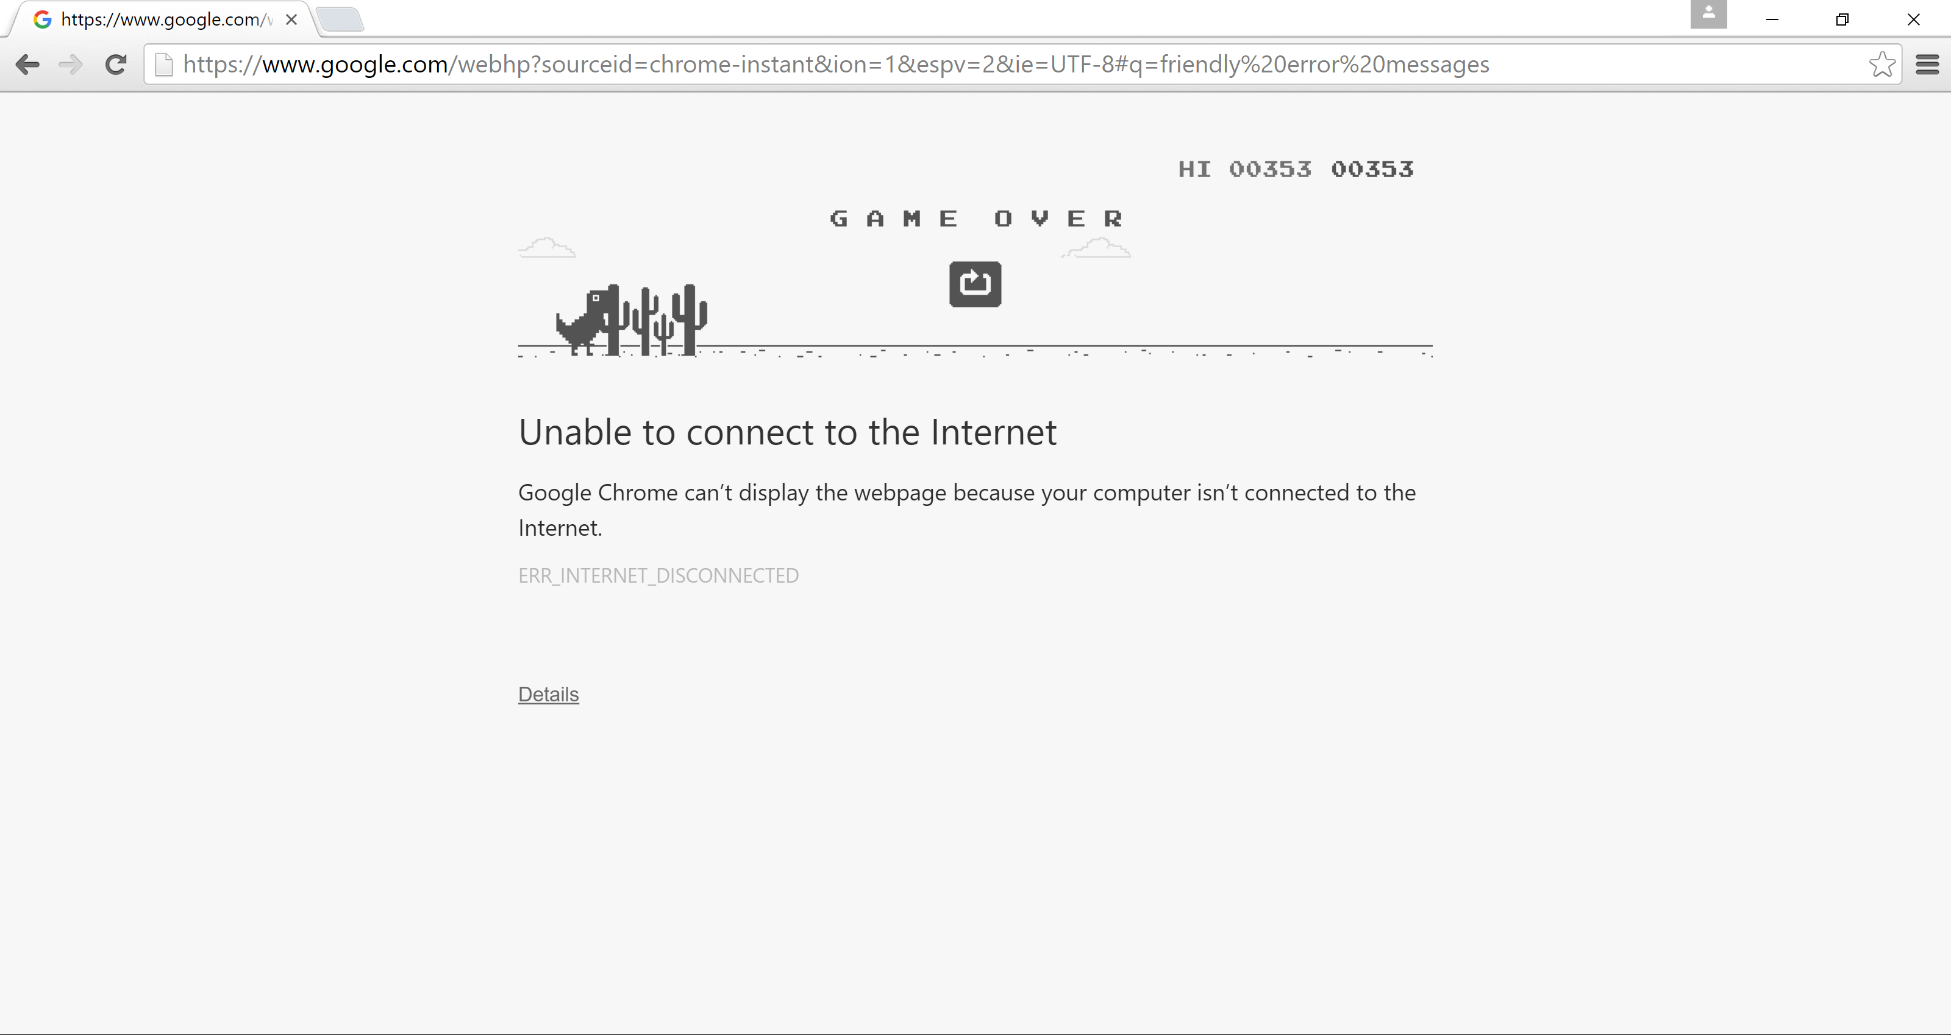
Ok… maybe too Actionable

Slide 46
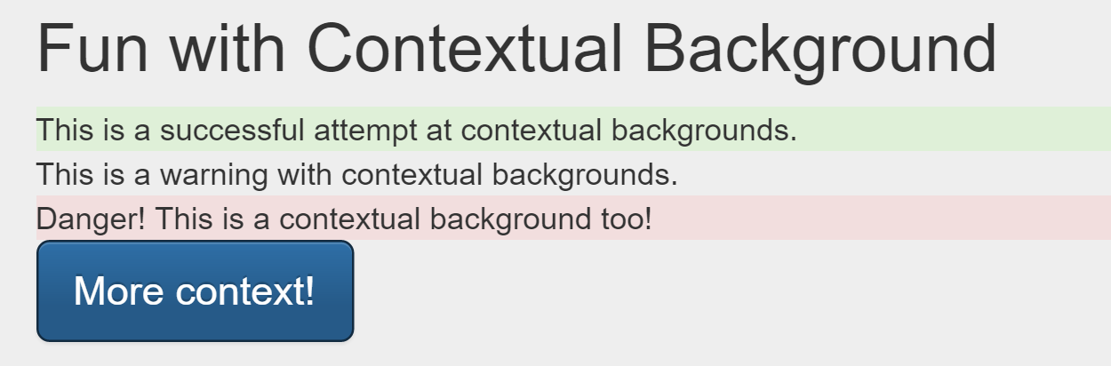
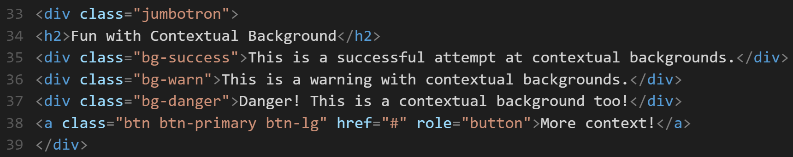
Contextual Messaging

Slide 47
Other Design and Development
Considerations

Slide 48
Your dog has died of dysentery.
Your dog has died of dysentery.
Your dog has died of dysentery.

Slide 49
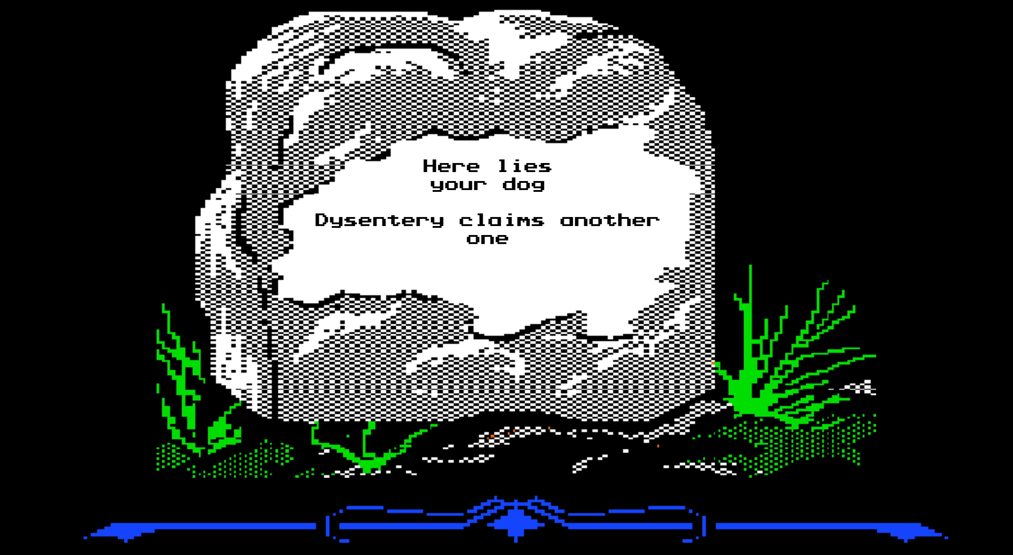

Generate your tomb at: http://www.oregontrailtombstone.com/

Slide 50








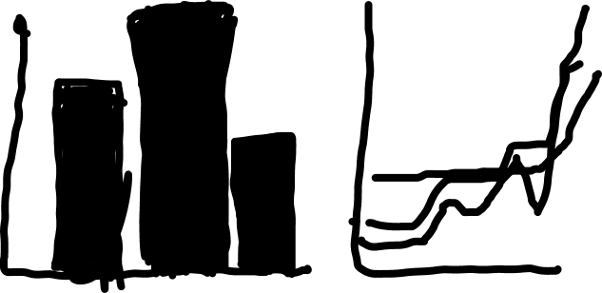


Data Visualization
Percentages
Quantity Comparison
Change Over Time Comparison

Slide 51
Usable Documentation

Slide 52
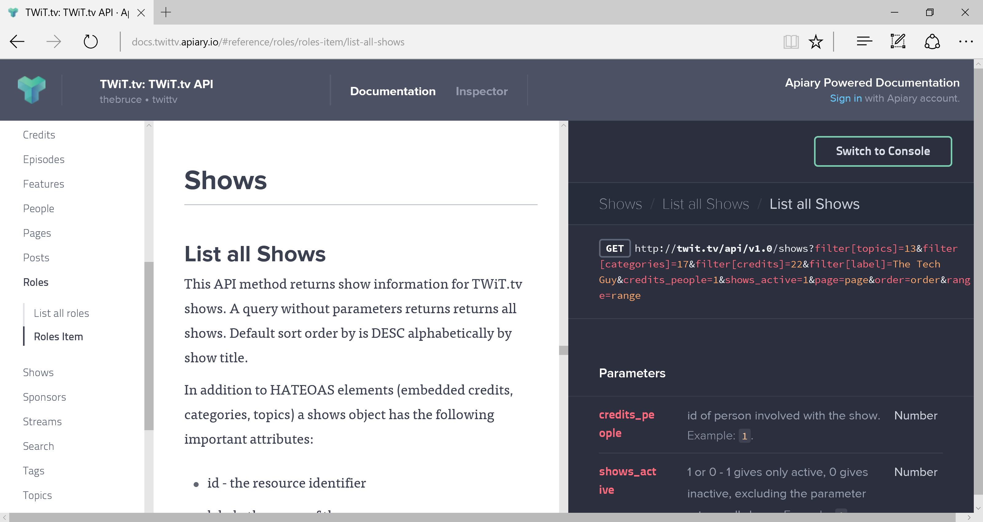

Slide 53
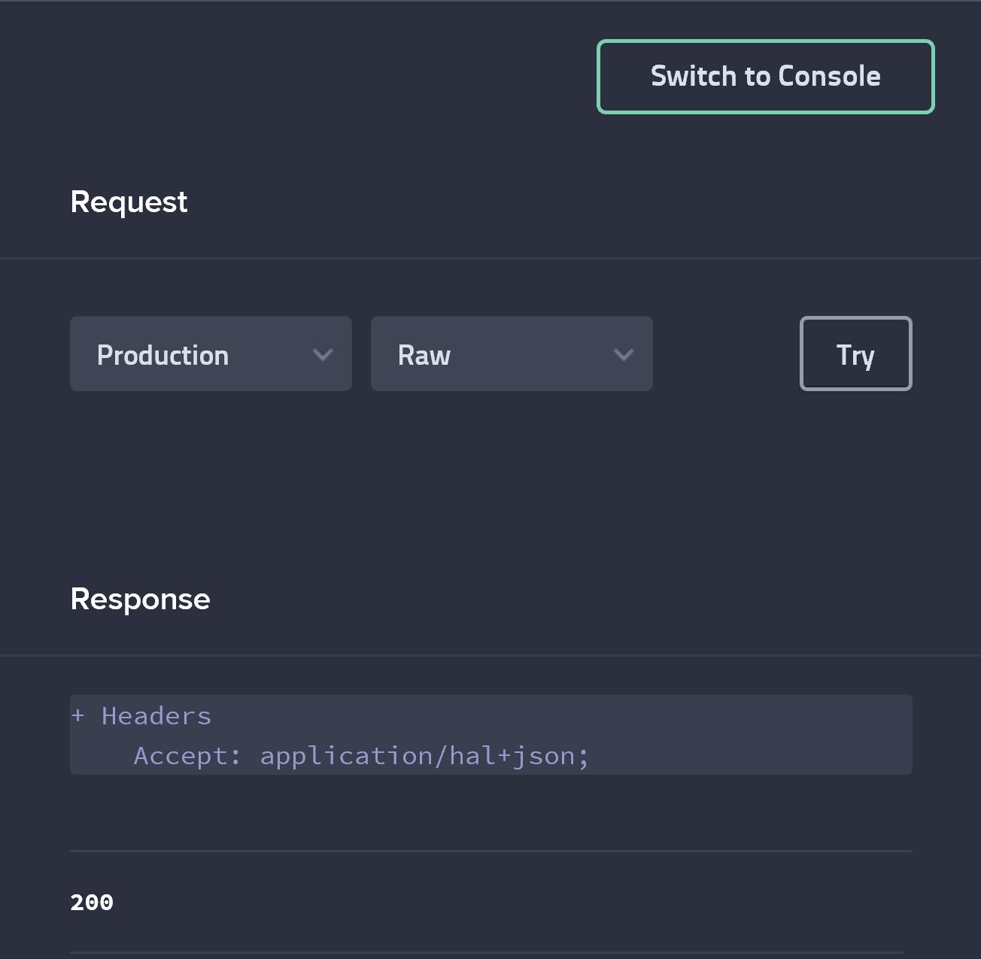

Slide 54
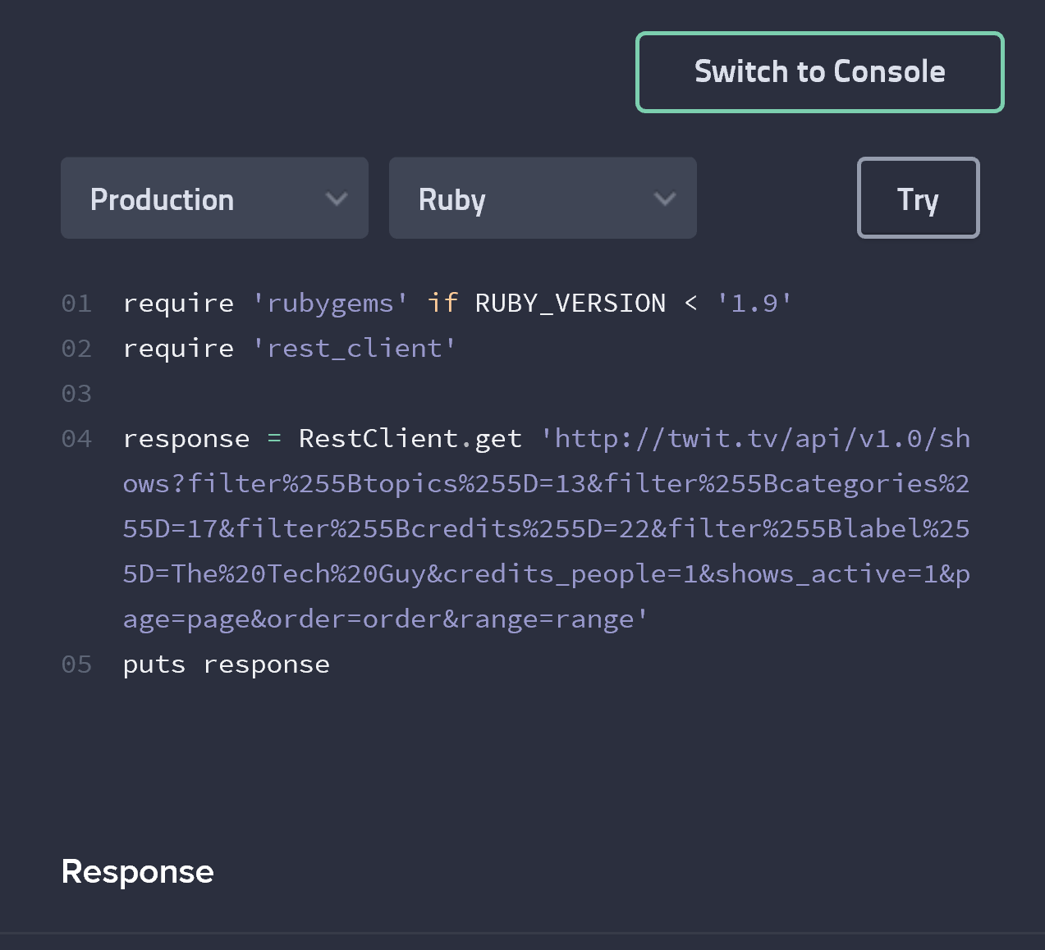

Slide 55
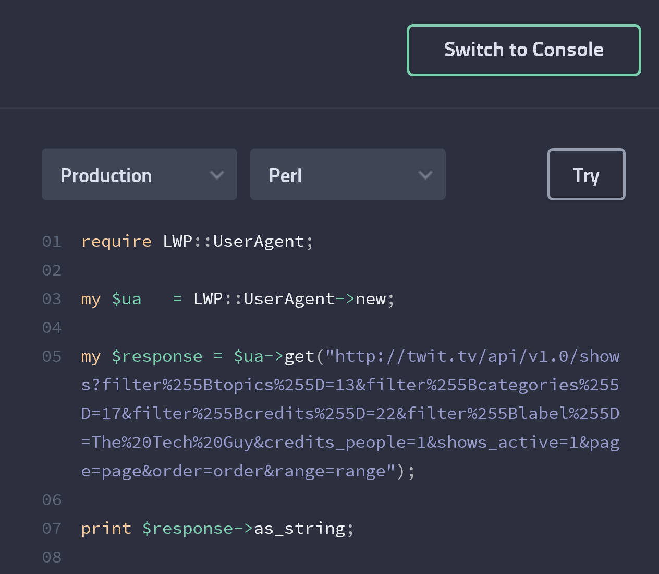

Slide 56
Testing
Design
Development
Analyze
Evolution/Finalize
Usability
Integration testing
Exploratory testing
Beta groups
Gather analytics

Slide 57
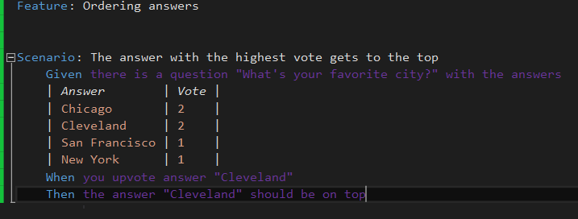
Sample Feature File

Slide 58
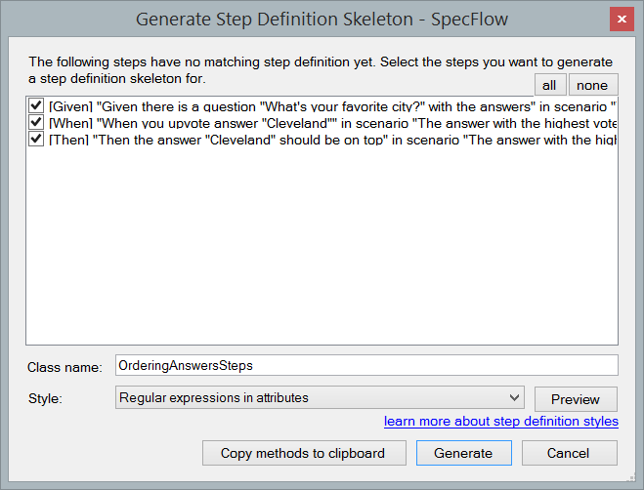
Generate Step Definitions

Slide 59
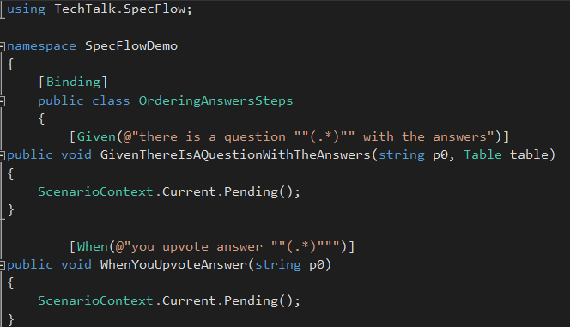
Generated Steps

Slide 60
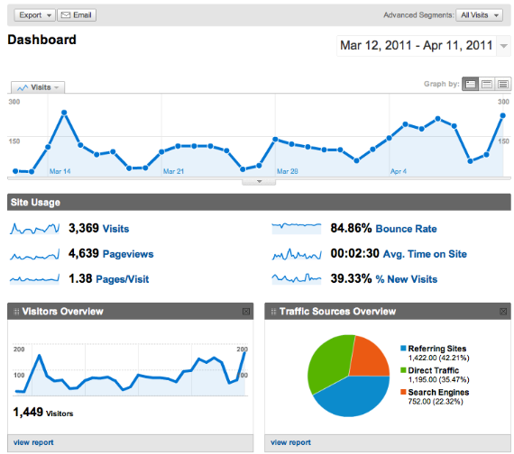
Google Analytics
Track information about visitors including:
Time on site
Pages visited
Location
Traffic source
Browser usage

Slide 61
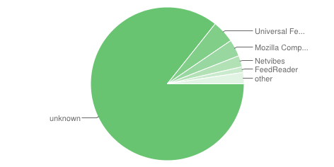
Feedburner
Used for tracking RSS feed subscriptions
Great for tracking people who read blogs in a feed reader

Slide 62
Evolution/ Finalize
Design
Testing
Development
Analyze
Gathering user feedback
App analytics

Slide 63
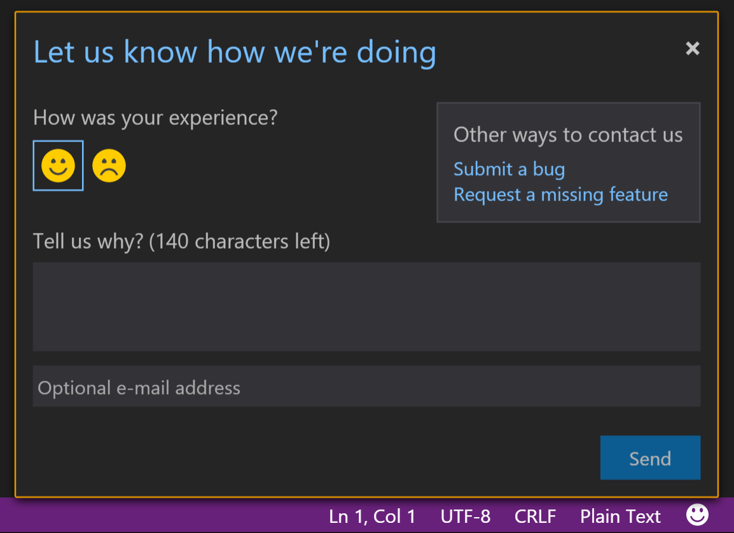
Ask for feedback. Give them options for different feedback!

Slide 64
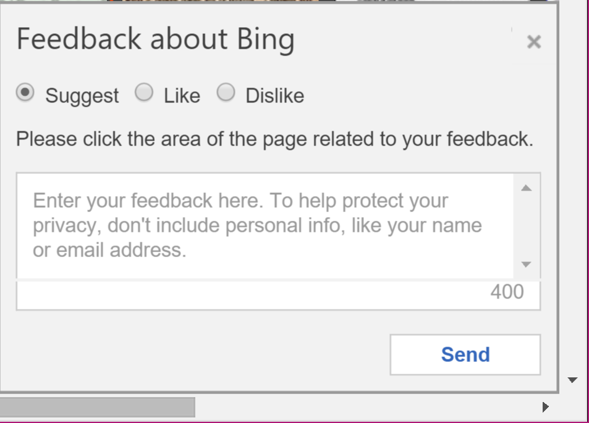

Notes:
Non-obtrusive

Slide 65
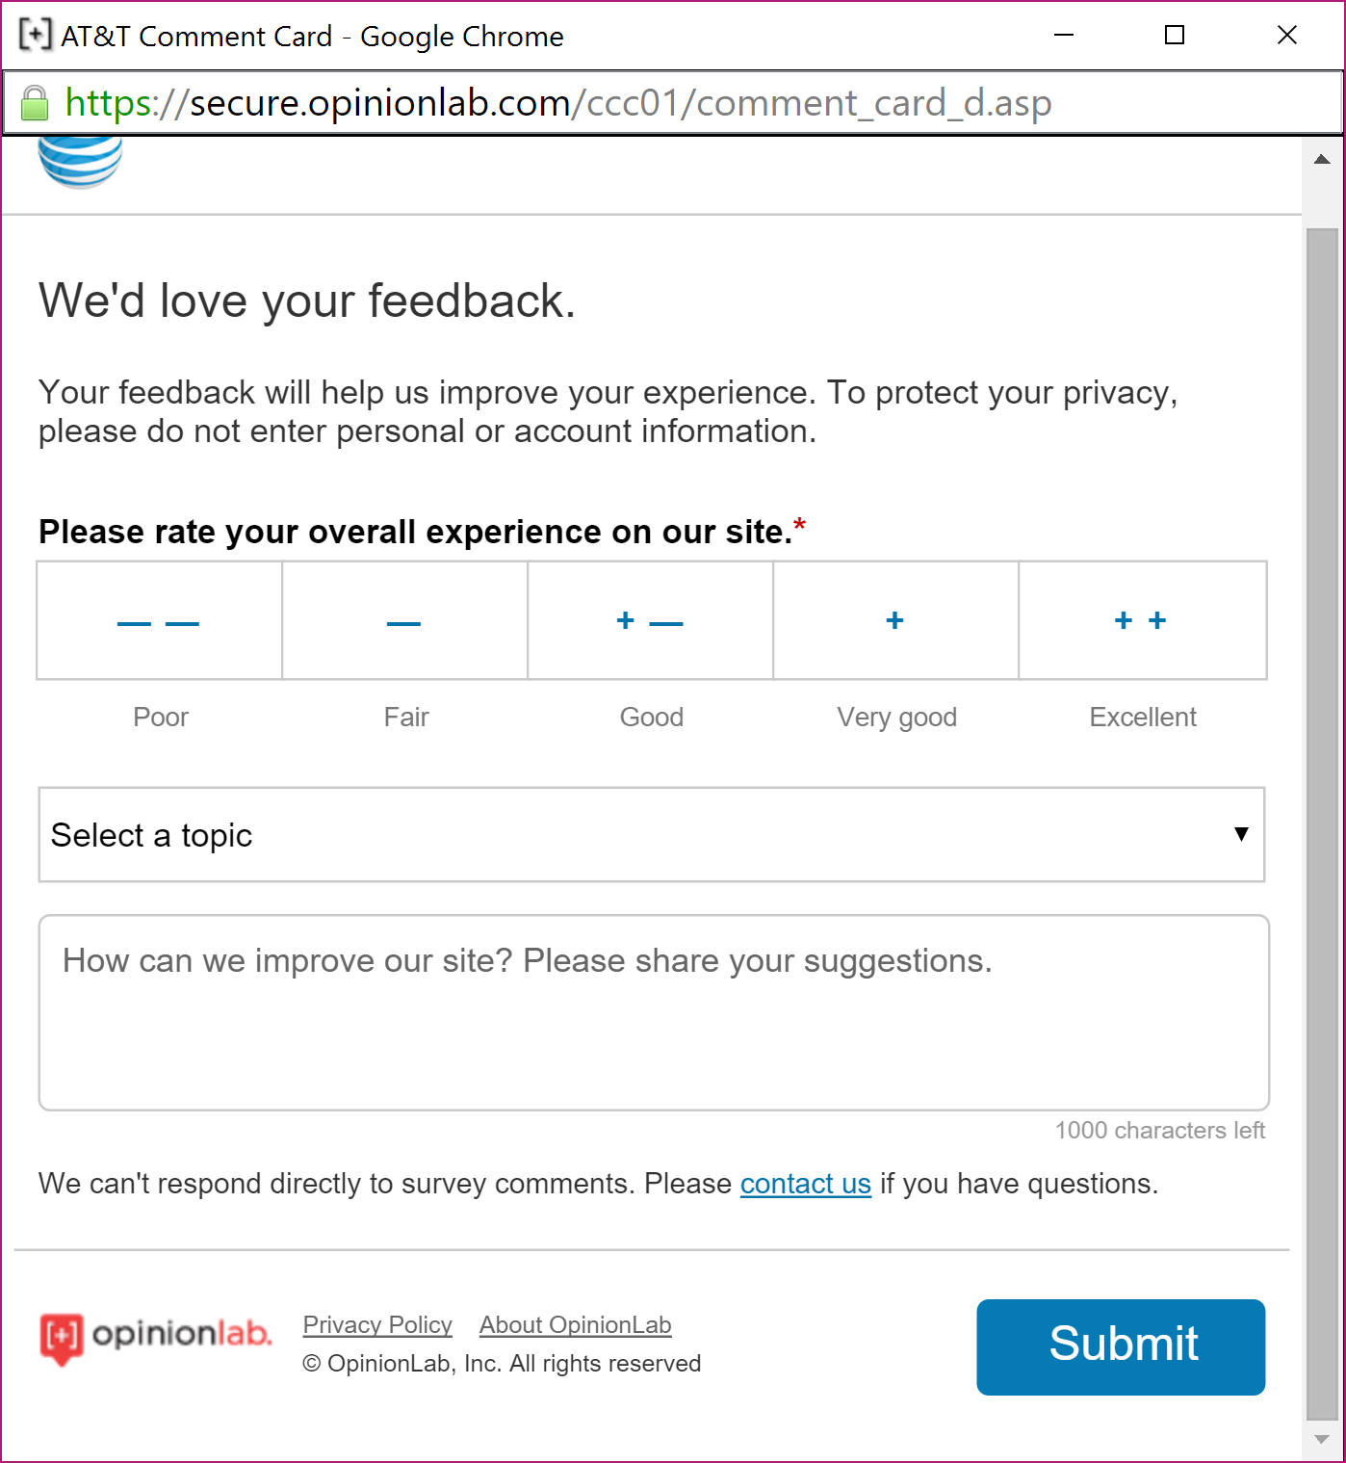

Slide 66







Slide 67


Demo: Michigan.gov study

Slide 68
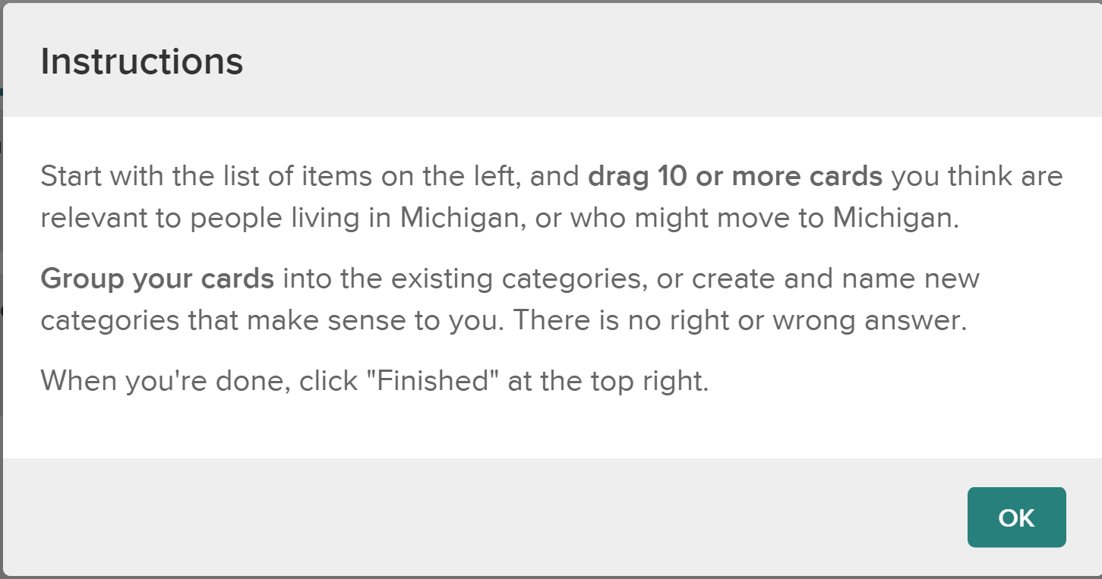

Slide 69
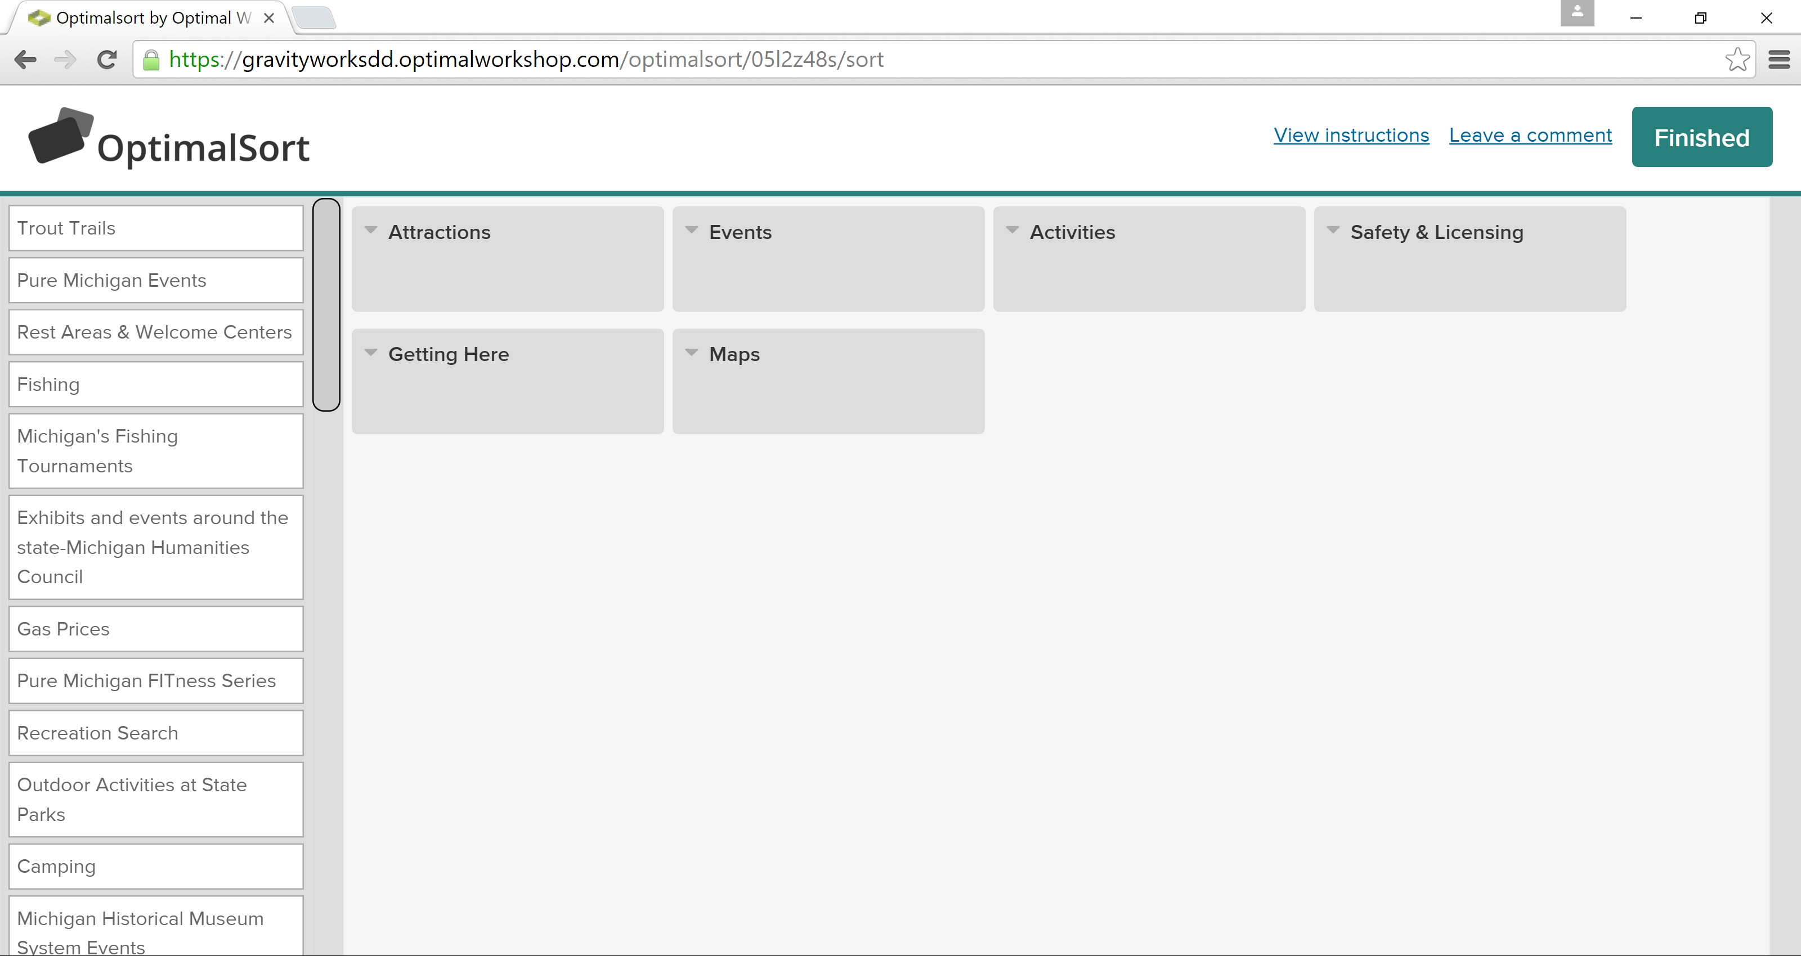

Slide 70

Notes:
Image from: https://openplacement.blob.core.windows.net/community/2014/09/report-a-problem-triangle.png

Slide 71
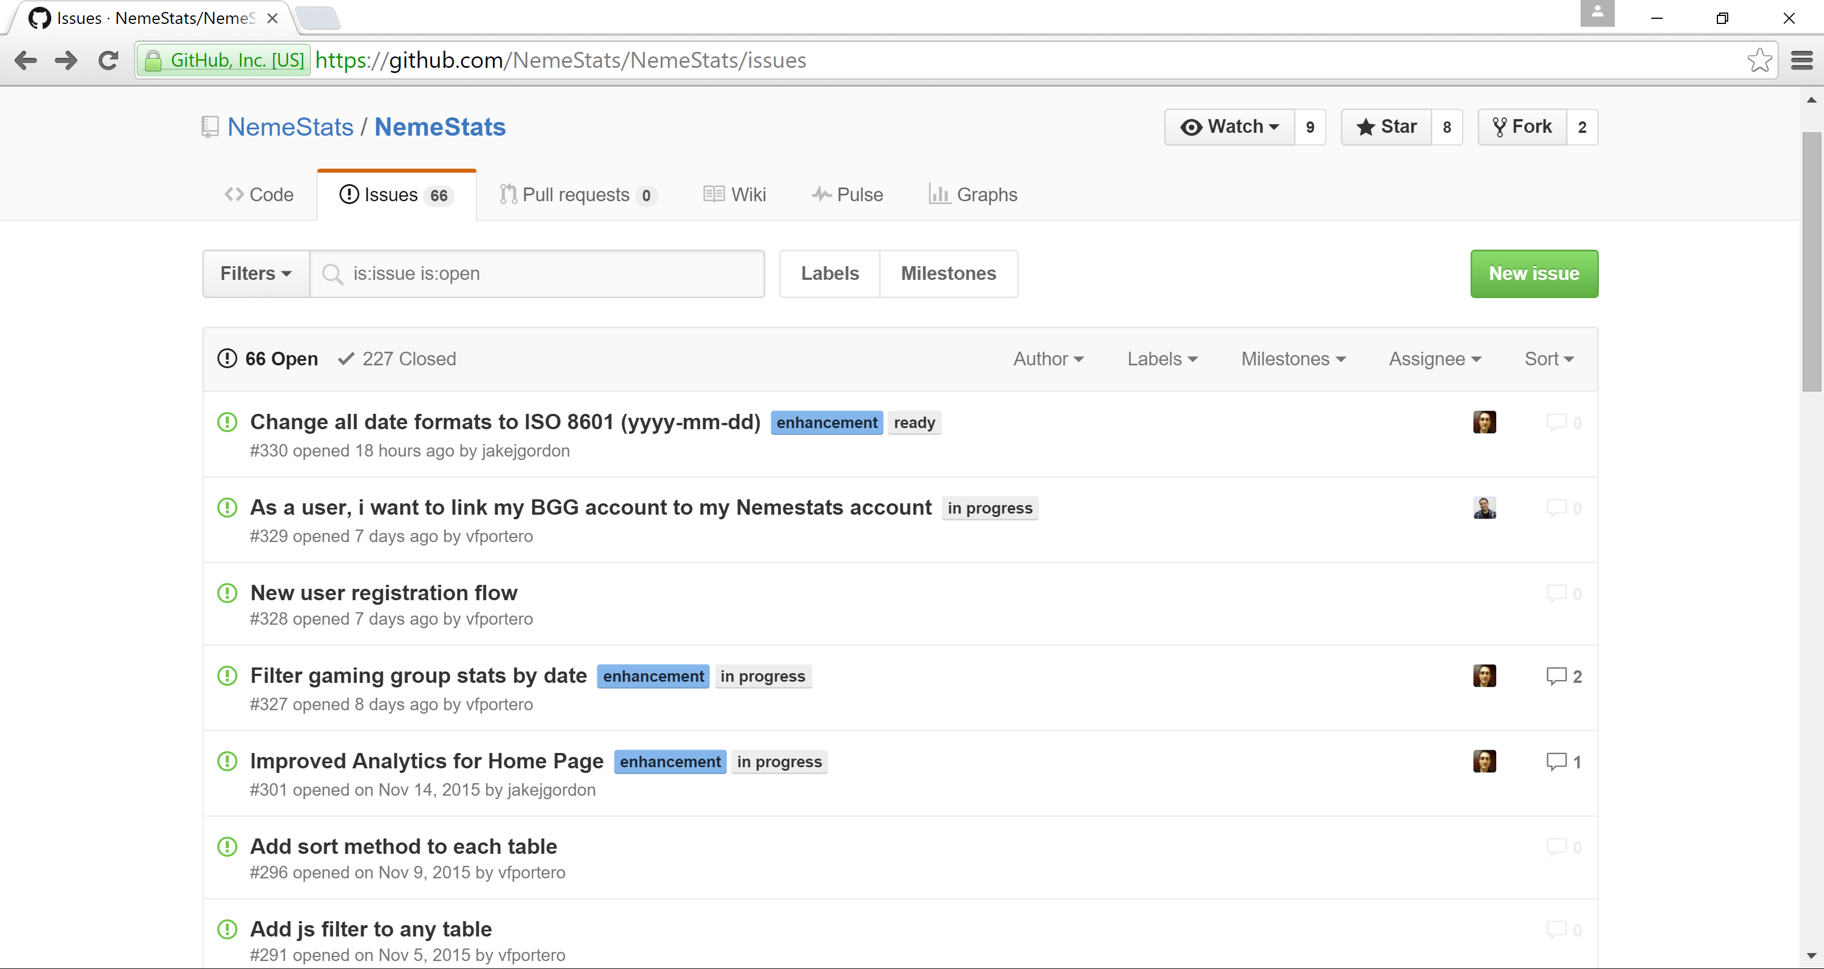

Slide 72
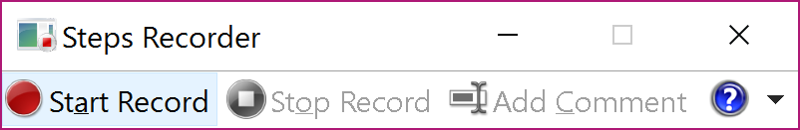
Windows 7 and higher
Capture clicks and steps taken
Add comments on what is expected

Slide 73
Customer Engagements
Meet in-person
Experience environment app is being used in
Make note of environmental conditions not accounted for in the design
Make note of processes not identified earlier

Slide 74
Tools
Bootstrap
Framework7
D3

Slide 75
Font Resources
Font Awesome
Fontello
Iconic
Entypo
Modern Pictograms
Typicons
Foundation Icon Fonts 2

Slide 76



Learn More…

Slide 77


More Reading…

Slide 78


Even More Reading…

Slide 79
Some UX-Related Sites
UX Matters - http://www.uxmatters.com
UX Week - http://uxweek.com/ - August 29 – September 1, 2017 – San Francisco, CA
Information Architecture Summit - http://www.iasummit.org/
UIE’s All You Can Learn(SM) Library - https://aycl.uie.com/
Rosenfeld Media Training - http://rosenfeldmedia.com/training/
Interaction Design Association (IxDA) - http://ixda.org/

Slide 80
Additional Resources
All About UX
UX for the masses - 25 great free UX tools
MSDN - Windows UX Design Principles
OS X Human Interface Guidelines
Mobile UX and Mobile UI guidelines: The 2014 Collection
UX is not UI
The Secret to Designing an Intuitive UX

Slide 81

Any questions?

